Slide 1
Database Design Using the E-R Model
Prof. X

Slide 2
Outline
Overview of the Design Process
The Entity-Relationship Model
Mapping Cardinalities
Primary Key
Removing Redundant Attributes in Entity Sets
Reducing ER Diagrams to Relational Schemas
Extended E-R Features
Entity-Relationship Design Issues
Alternative Notations for Modeling Data

Slide 3
Design Phases
Initial phase -- characterize fully the data needs of the prospective database users.
Second phase -- choosing a data model
Applying the concepts of the chosen data model
Translating these requirements into a conceptual schema of the database.
A fully developed conceptual schema indicates the functional requirements of the enterprise.
Describe the kinds of operations (or transactions) that will be performed on the data.

Slide 4
Design Phases (Cont.)
Final Phase -- Moving from an abstract data model to the implementation of the database
Logical Design – Deciding on the database schema.
Database design requires that we find a “good” collection of relation schemas.
Business decision – What attributes should we record in the database?
Computer Science decision – What relation schemas should we have and how should the attributes be distributed among the various relation schemas?
Physical Design – Deciding on the physical layout of the database

Slide 5
Design Alternatives
In designing a database schema, we must ensure that we avoid two major pitfalls:
Redundancy: a bad design may result in repeat information.
Redundant representation of information may lead to data inconsistency among the various copies of information
Incompleteness: a bad design may make certain aspects of the enterprise difficult or impossible to model.
Avoiding bad designs is not enough. There may be a large number of good designs from which we must choose.

Slide 6
Design Approaches
Entity Relationship Model
Models an enterprise as a collection of entities and relationships
Entity: a “thing” or “object” in the enterprise that is distinguishable from other objects
Described by a set of attributes
Relationship: an association among several entities
Represented diagrammatically by an entity-relationship diagram:
Normalization Theory
Formalize what designs are bad, and test for them

Slide 7
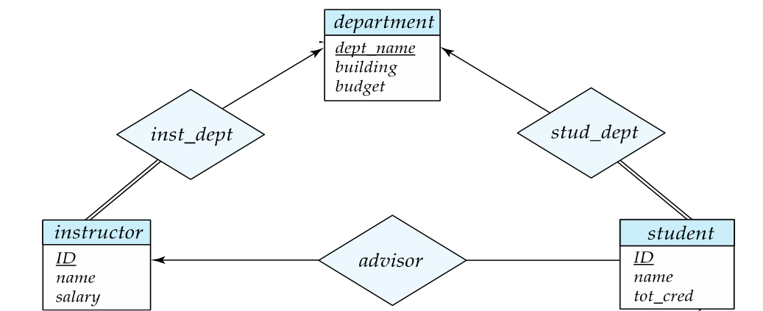
ER model -- Database Modeling
The ER data model employs three basic concepts:
entity sets,
relationship sets,
attributes.
The ER model also has an associated diagrammatic representation, the ER diagram, which can express the overall logical structure of a database graphically.

Slide 8
Entity Sets
An entity is an object that exists and is distinguishable from other objects.
Example: specific person, company, event, plant
An entity set is a set of entities of the same type that share the same properties.
Example: set of all persons, companies, trees, holidays
An entity is represented by a set of attributes; i.e., descriptive properties possessed by all members of an entity set.
Example:
instructor = (ID, name, salary ) course= (course_id, title, credits)
A subset of the attributes form a primary key of the entity set which uniquely identify each member (entity) of the set.

Slide 9
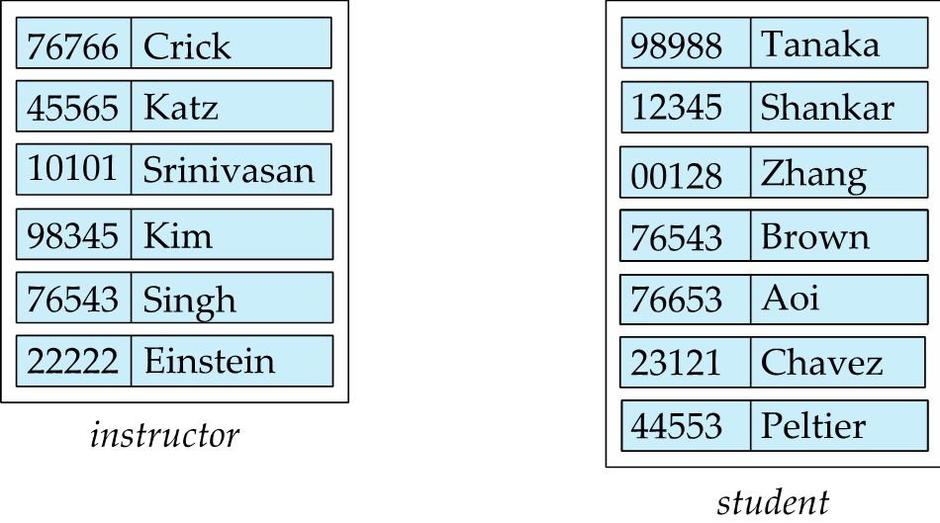
Entity Sets -- instructor and student

Slide 10
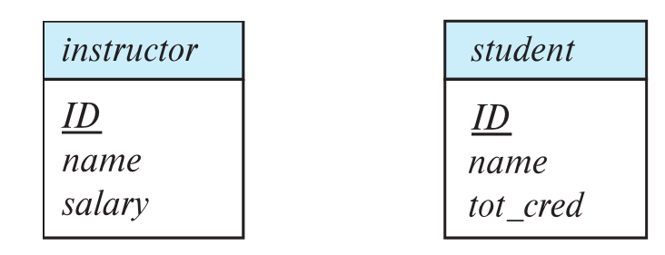
Representing Entity sets in ER Diagram
Entity sets can be represented graphically as follows:
Rectangles represent entity sets.
Attributes listed inside entity rectangle
Underline indicates primary key attribute(s)

Slide 11
Relationship Sets
A relationship is an association among several entities
Example: 44553 (Peltier) advisor 22222 (Einstein) student entity relationship set instructor entity
A relationship set is a mathematical relation among n ≥ 2 entities, each taken from entity sets
{(e₁, e₂, … e_{n}) | e₁ ∈ E₁, e₂ ∈ E₂, …, e_{n} ∈ E_{n}} where (e₁, e₂, …, e_{n}) is a relationship
Example:
(44553 (Peltier), 22222 (Einstein)) ∈ advisor

Slide 12
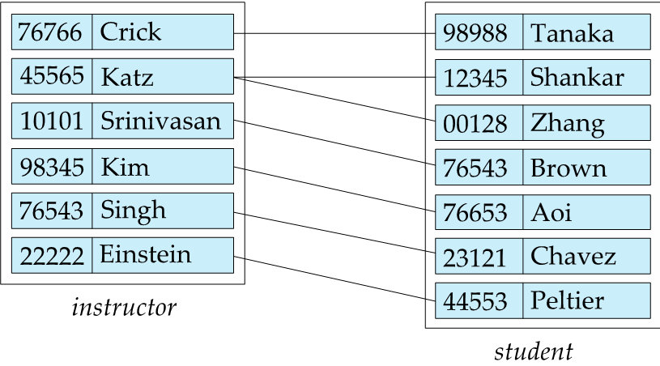
Relationship Sets (Cont.)
Example: we define the relationship set advisor to denote the associations between students and the instructors who act as their advisors.
Pictorially, we draw a line between related entities.

Slide 13
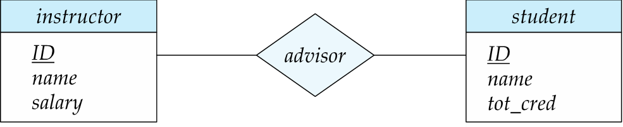
Representing Relationship Sets via ER Diagrams
Diamonds represent relationship sets.

Slide 14
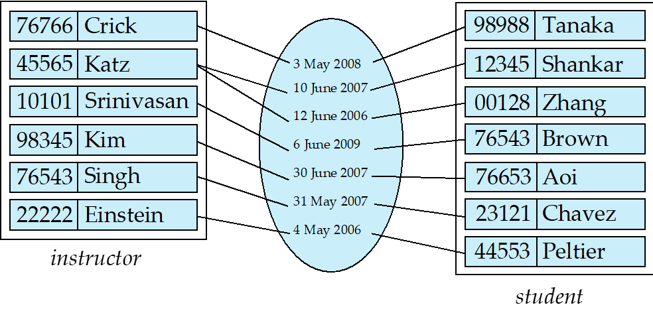
Relationship Sets (Cont.)
Attribute(s) can also be associated with a relationship set.
For instance, the advisor relationship set between entity sets instructor and student may have the attribute date which tracks when the student started being associated with the advisor

Slide 15
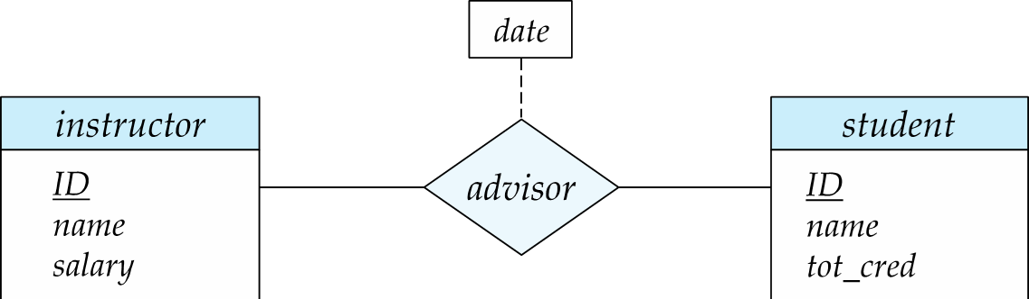
Relationship Sets with Attributes

Slide 16
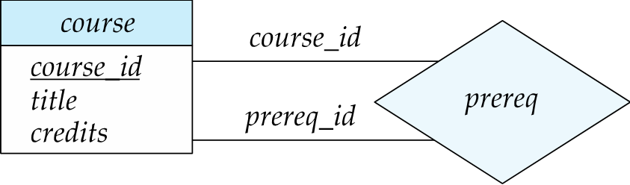
Roles
Entity sets of a relationship need not be distinct
Each occurrence of an entity set plays a “role” in the relationship
The labels “course_id” and “prereq_id” are called roles.

Slide 17
Degree of a Relationship Set
Binary relationship Set
involve two entity sets (or degree two).
most relationship sets in a database system are binary.
Relationships among more than two entity sets are rare. Most relationships are binary.
Example: students work on research projects under the guidance of an instructor.
relationship proj_guide is a ternary relationship among instructor, student, and project

Slide 18
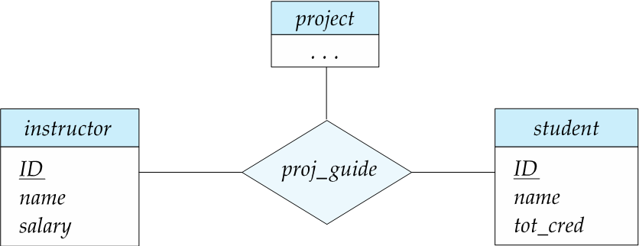
Non-binary Relationship Sets
Most relationship sets are binary
There are occasions when it is more convenient to represent relationships as non-binary.
E-R Diagram with a Ternary Relationship

Slide 19
Mapping Cardinality Constraints
Express the number of entities to which another entity can be associated via a relationship set.
Most useful in describing binary relationship sets.
For a binary relationship set, the mapping cardinality must be one of the following types:
One to one
One to many
Many to one
Many to many

Slide 20
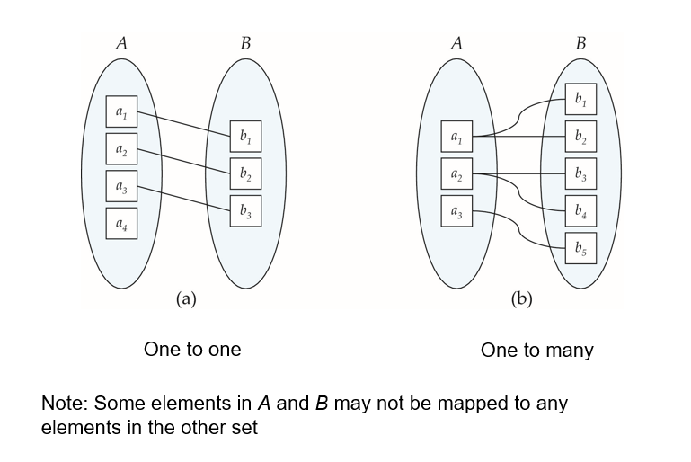
Mapping Cardinalities

Slide 21
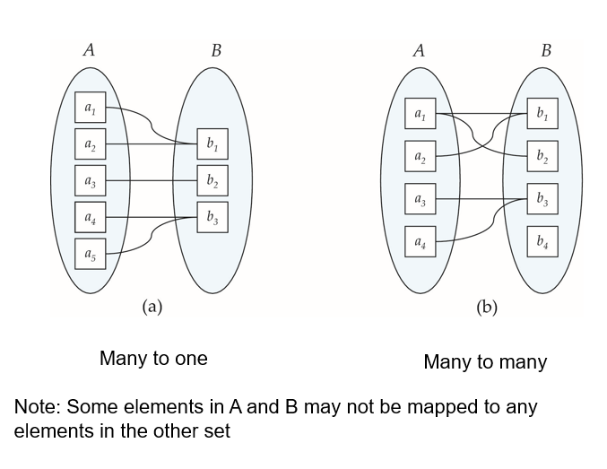
Mapping Cardinalities

Slide 22
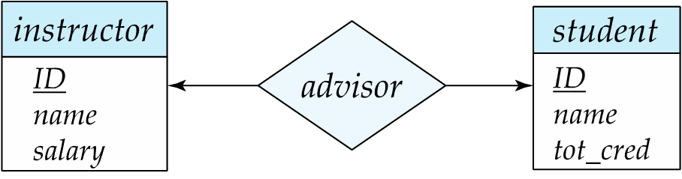
Representing Cardinality Constraints in ER Diagram
We express cardinality constraints by drawing either a directed line (→), signifying “one,” or an undirected line (—), signifying “many,” between the relationship set and the entity set.
One-to-one relationship between an instructor and a student :
A student is associated with at most one instructor via the relationship advisor
An instructor is associated with at most one student

Slide 23
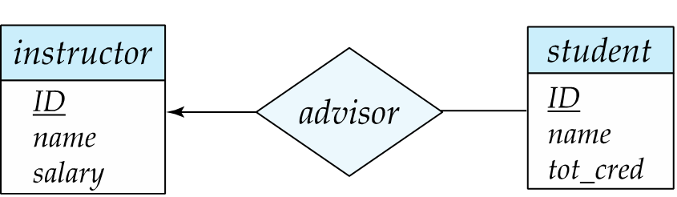
One-to-Many Relationship
one-to-many relationship between an instructor and a student
an instructor is associated with several (including 0) students via advisor
a student is associated with at most one instructor via advisor

Slide 24
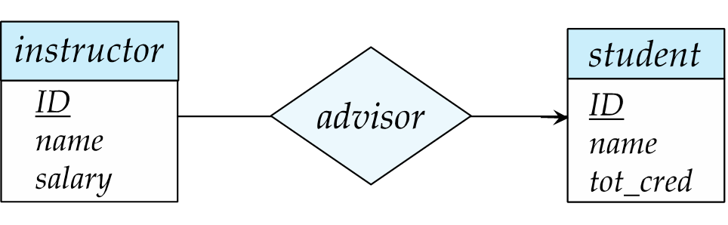
Many-to-One Relationships
In a many-to-one relationship between an instructor and a student,
an instructor is associated with at most one student via advisor,
and a student is associated with several (including 0) instructors via advisor

Slide 25
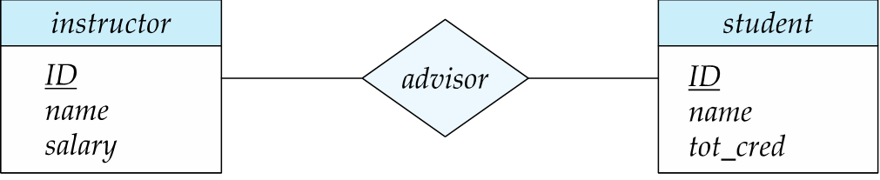
Many-to-Many Relationship
An instructor is associated with several (possibly 0) students via advisor
A student is associated with several (possibly 0) instructors via advisor

Slide 26
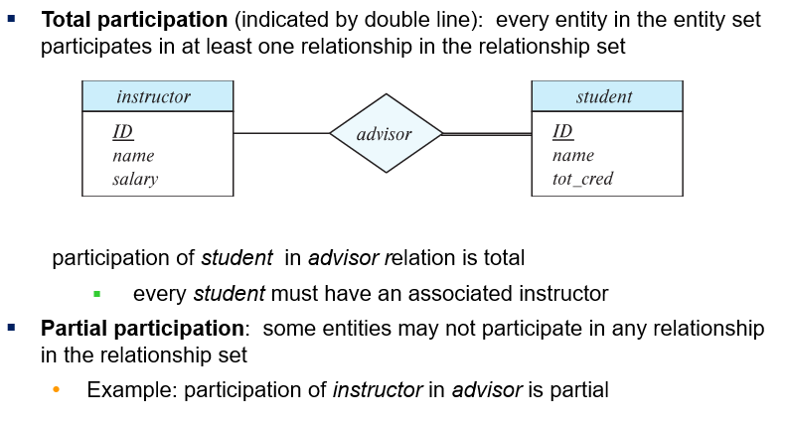
Total and Partial Participation

Slide 27
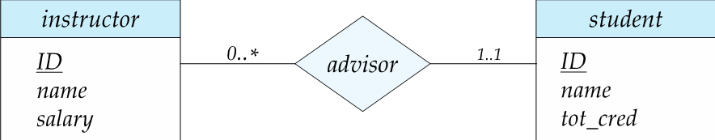
Notation for Expressing More Complex Constraints
A line may have an associated minimum and maximum cardinality, shown in the form l..h, where l is the minimum and h the maximum cardinality
A minimum value of 1 indicates total participation.
A maximum value of 1 indicates that the entity participates in at most one relationship
A maximum value of * indicates no limit.
Example
Instructor can advise 0 or more students. A student must have 1 advisor; cannot have multiple advisors

Slide 28
Primary Key
Primary keys provide a way to specify how entities and relations are distinguished. We will consider:
Entity sets
Relationship sets.
Weak entity sets

Slide 29
Primary key for Entity Sets
By definition, individual entities are distinct.
From database perspective, the differences among them must be expressed in terms of their attributes.
The attribute values of an entity must be such that they can uniquely identify the entity.
No two (different) entities in an entity set are allowed to have exactly the same value for all attributes.
A key for an entity is a set of attributes that is sufficient to distinguish entities from each other

Slide 30
Primary Key for Relationship Sets
The choice of the primary key for a relationship set depends on the mapping cardinality of the relationship set.
Many-to-Many relationships. The union of the primary keys of every entity set is a minimal superkey and is chosen as the primary key.
For example, if advisor is Many-to-Many, then (Student_ID, Instructor_ID) is the primary key of advisor.
One-to-Many relationships . The primary key of the “Many” side is a minimal superkey and is used as the primary key.
Many-to-one relationships. The primary key of the “Many” side is a minimal superkey and is used as the primary key.
One-to-one relationships. The primary key of either one of the participating entity sets forms a minimal superkey, and either one can be chosen as the primary key.

Slide 31
Weak Entity Sets
Consider a section entity, which is uniquely identified by a course_id, semester, year, and sec_id.
Clearly, section entities are related to course entities. Suppose we create a relationship set sec_course between entity sets section and course.
Note that the information in sec_course is redundant, since section already has an attribute course_id, which identifies the course with which the section is related.
One option to deal with this redundancy is to get rid of the relationship sec_course; however, by doing so the relationship between section and course becomes implicit, which is not desirable.

Slide 32
Weak Entity Sets (Cont.)
An alternative way to deal with this redundancy is to not store the attribute course_id in the section entity and to only store the remaining attributes section_id, year, and semester.
However, the entity set section then does not have enough attributes to identify a particular section entity uniquely
To deal with this problem, we treat the relationship sec_course as a special relationship that provides extra information, in this case, the course_id, required to identify section entities uniquely.
A weak entity set is one whose existence is dependent on another entity, called its identifying entity
Instead of associating a primary key with a weak entity, we use the identifying entity, along with extra attributes called discriminator to uniquely identify a weak entity.

Slide 33
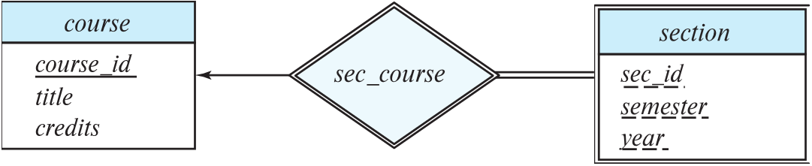
Expressing Weak Entity Sets
In E-R diagrams, a weak entity set is depicted via a double rectangle.
We underline the discriminator of a weak entity set with a dashed line.
The relationship set connecting the weak entity set to the identifying strong entity set is depicted by a double diamond.
Primary key for section – (course_id, sec_id, semester, year)

Slide 34
Weak Entity Sets (Cont.)
An entity set that is not a weak entity set is termed a strong entity set.
Every weak entity must be associated with an identifying entity; that is, the weak entity set is said to be existence dependent on the identifying entity set.
The identifying entity set is said to own the weak entity set that it identifies.
The relationship associating the weak entity set with the identifying entity set is called the identifying relationship.
Note that the relational schema (SQL: create table section…) we eventually create from the entity set section does have the attribute course_id, even though we have dropped the attribute course_id from the entity set section.

Slide 35
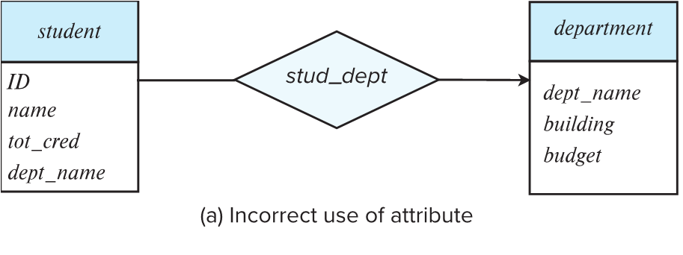
Redundant Attributes
Suppose we have entity sets:
student, with attributes: ID, name, tot_cred, dept_name
department, with attributes: dept_name, building, budget
We model the fact that each student has an associated department using a relationship set stud_dept
The attribute dept_name in student below replicates information present in the relationship and is therefore redundant
and needs to be removed.
removing it from the E-R model does NOT mean it is removed from the relation schema

Slide 36
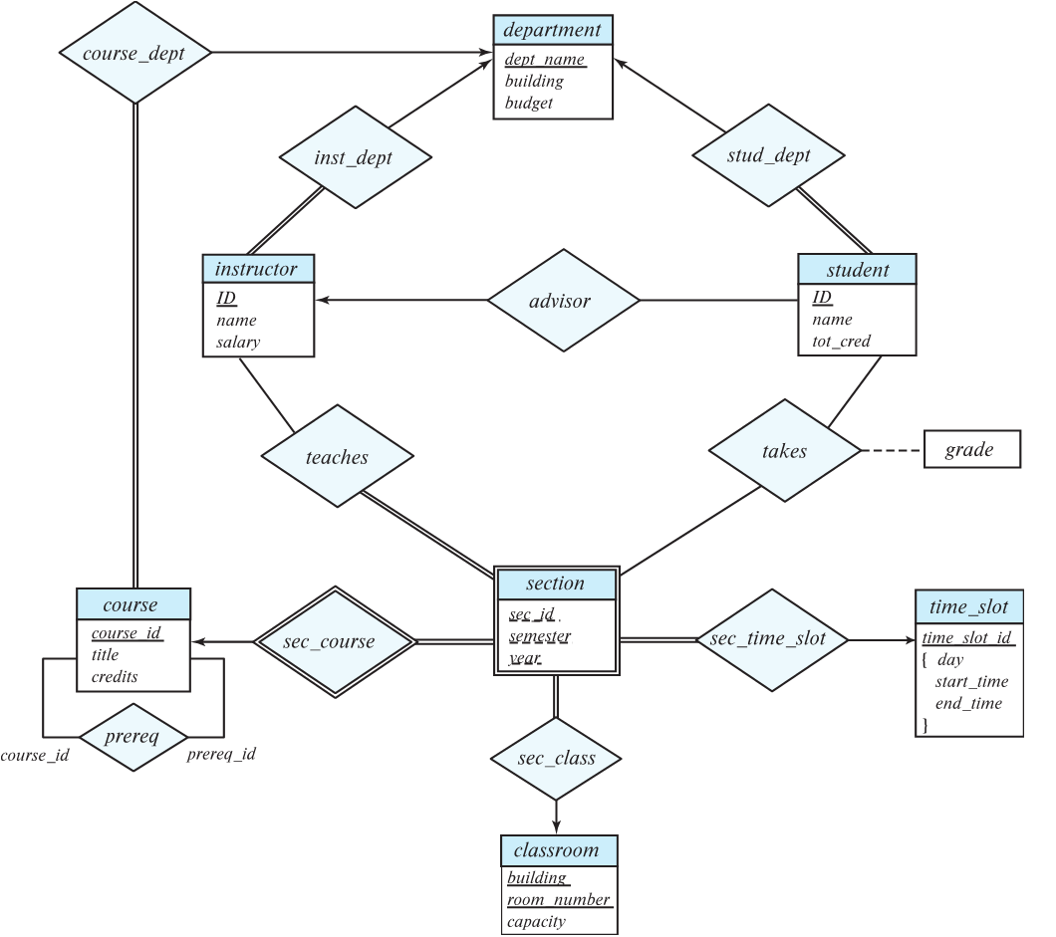
E-R Diagram for a University Enterprise

Slide 37
Reduction to Relation Schemas
Entity sets and relationship sets can be expressed uniformly as relation schemas that represent the contents of the database.
A database which conforms to an E-R diagram can be represented by a collection of schemas.
For each entity set and relationship set there is a unique schema that is assigned the name of the corresponding entity set or relationship set.
Each schema has a number of columns (generally corresponding to attributes), which have unique names.

Slide 38
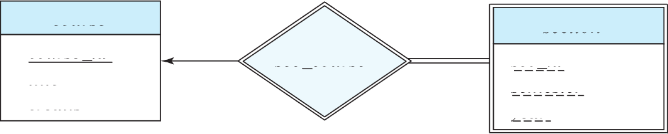
Representing Entity Sets
A strong entity set reduces to a schema with the same attributes
student(ID, name, tot_cred)
A weak entity set becomes a table that includes a column for the primary key of the identifying strong entity set
section ( course_id, sec_id, sem, year )
Example

Slide 39
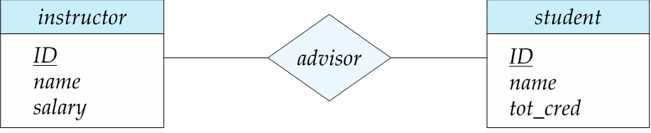
Representing Relationship Sets
A many-to-many relationship set is represented as a schema with attributes for the primary keys of the two participating entity sets, and any descriptive attributes of the relationship set.
Example: schema for relationship set advisor
advisor = (s_id, i_id)

Slide 40

Redundancy of Schemas
Many-to-one and one-to-many relationship sets that are total on the many-side can be represented by adding an extra attribute to the “many” side, containing the primary key of the “one” side
Example: Add cdid (The primary key of the “one” side) to Track (“many” side)
Example: Instead of creating a schema for relationship set inst_dept, add an attribute dept_name to the schema arising from entity set instructor

Slide 41
Redundancy of Schemas (Cont.)
For one-to-one relationship sets, either side can be chosen to act as the “many” side
That is, an extra attribute can be added to either of the tables corresponding to the two entity sets
If participation is partial on the “many” side, replacing a schema by an extra attribute in the schema corresponding to the “many” side could result in null values

Slide 42
Specialization
Top-down design process; we designate sub-groupings within an entity set that are distinctive from other entities in the set.
These sub-groupings become lower-level entity sets that have attributes or participate in relationships that do not apply to the higher-level entity set.
Depicted by a triangle component labeled ISA (e.g., instructor “is a” person).
Attribute inheritance – a lower-level entity set inherits all the attributes and relationship participation of the higher-level entity set to which it is linked.

Slide 43
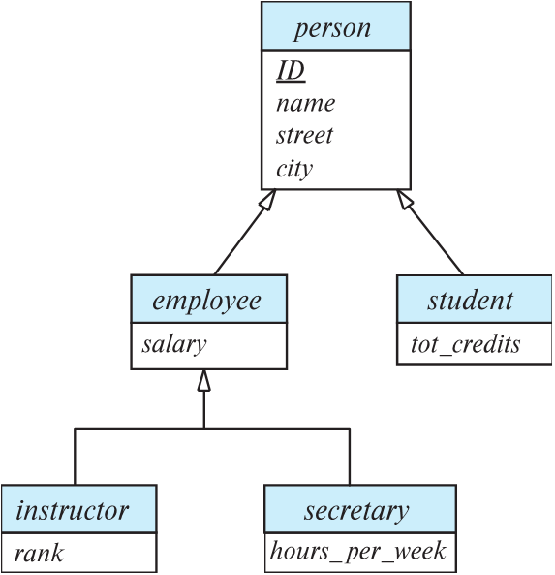
Specialization Example
Overlapping – employee and student
Disjoint – instructor and secretary
Total and partial

Slide 44
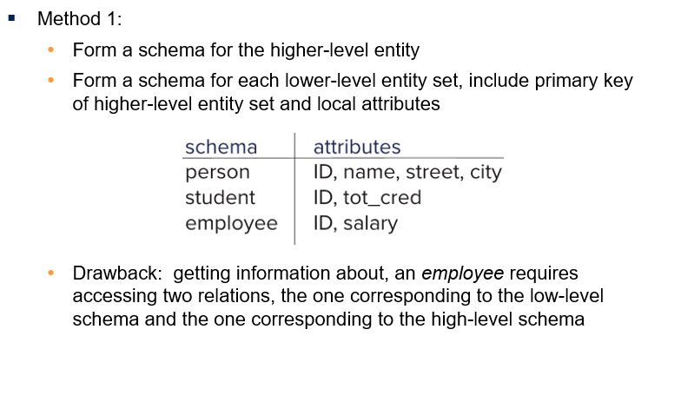
Representing Specialization via Schemas

Slide 45
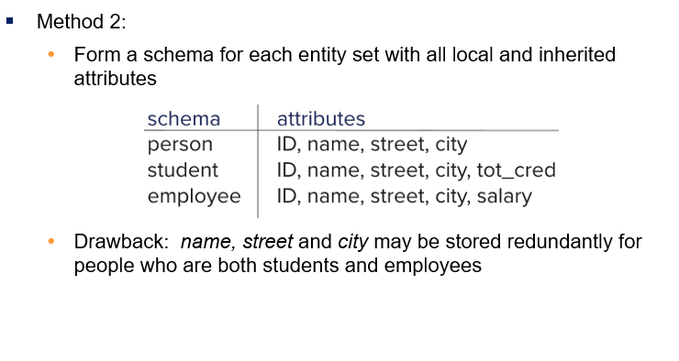
Representing Specialization as Schemas (Cont.)

Slide 46
Generalization
A bottom-up design process – combine a number of entity sets that share the same features into a higher-level entity set.
Specialization and generalization are simple inversions of each other; they are represented in an E-R diagram in the same way.
The terms specialization and generalization are used interchangeably.

Slide 47
Completeness constraint
Completeness constraint -- specifies whether or not an entity in the higher-level entity set must belong to at least one of the lower-level entity sets within a generalization.
total: an entity must belong to one of the lower-level entity sets
partial: an entity need not belong to one of the lower-level entity sets
Example, if every person must be a student or an employee, then it is total

Slide 48
Completeness constraint (Cont.)
Partial generalization is the default.
We can specify total generalization in an ER diagram by adding the keyword total in the diagram and drawing a dashed line from the keyword to the corresponding hollow arrow-head to which it applies (for a total generalization), or to the set of hollow arrow-heads to which it applies (for an overlapping generalization).
The student generalization is total: All student entities must be either graduate or undergraduate. Because the higher-level entity set arrived at through generalization is generally composed of only those entities in the lower-level entity sets, the completeness constraint for a generalized higher-level entity set is usually total

Slide 49
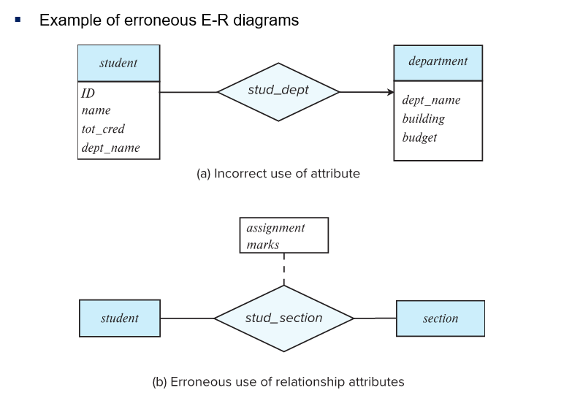
Common Mistakes in E-R Diagrams

Slide 50
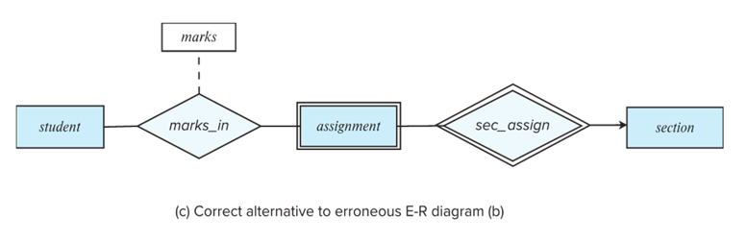
Common Mistakes in E-R Diagrams (Cont.)

Slide 51
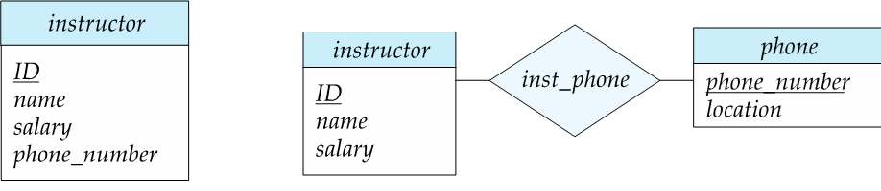
Entities vs. Attributes
Use of entity sets vs. attributes
Use of phone as an entity allows extra information about phone numbers (plus multiple phone numbers)

Slide 52
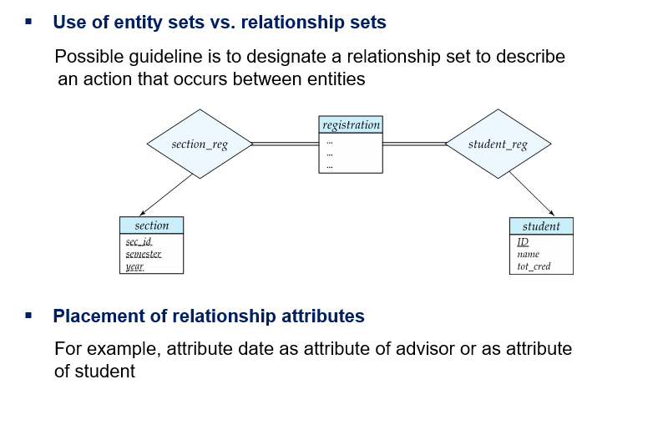
Entities vs. Relationship sets

Slide 53
E-R Design Decisions
The use of an attribute or entity set to represent an object.
Whether a real-world concept is best expressed by an entity set or a relationship set.
The use of a ternary relationship versus a pair of binary relationships.
The use of a strong or weak entity set.
The use of specialization/generalization – contributes to modularity in the design.
The use of aggregation – can treat the aggregate entity set as a single unit without concern for the details of its internal structure.

Slide 54
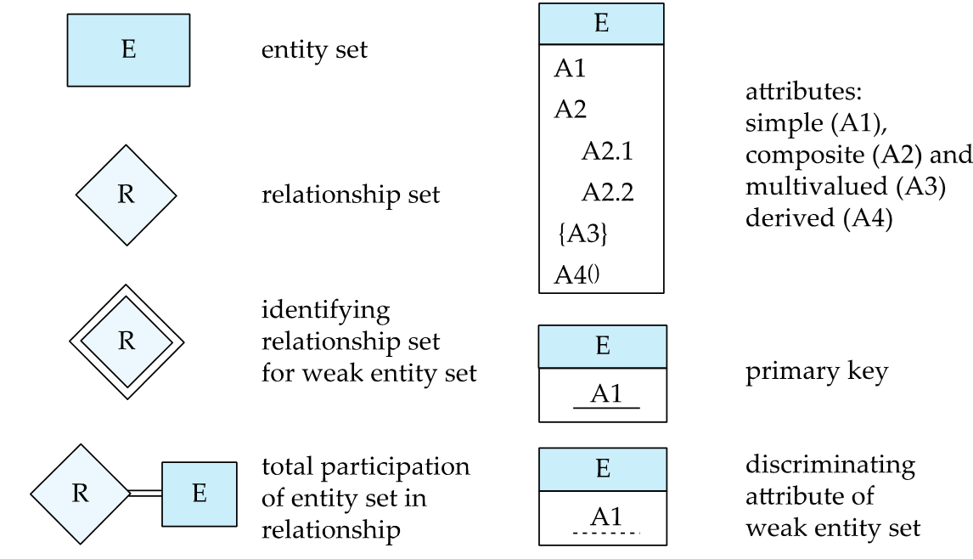
Summary of Symbols Used in E-R Notation

Slide 55
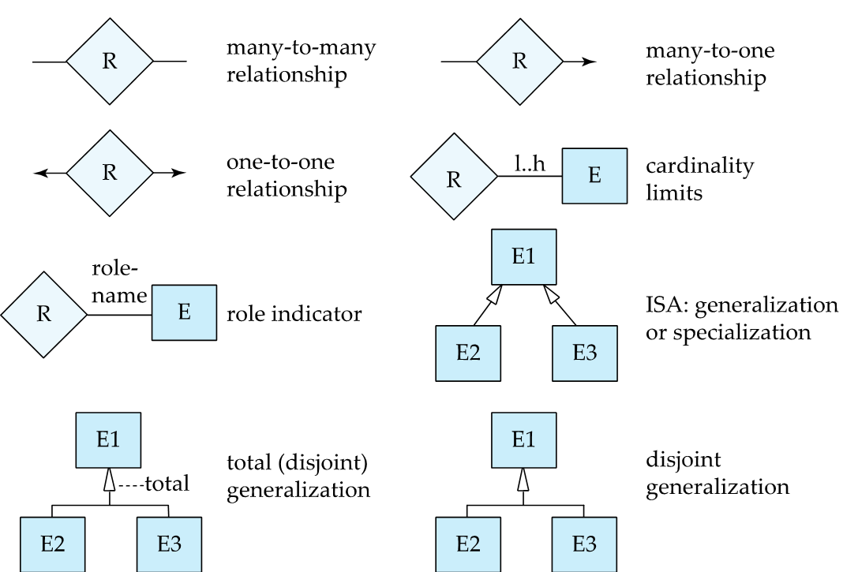
Symbols Used in E-R Notation (Cont.)

Slide 56
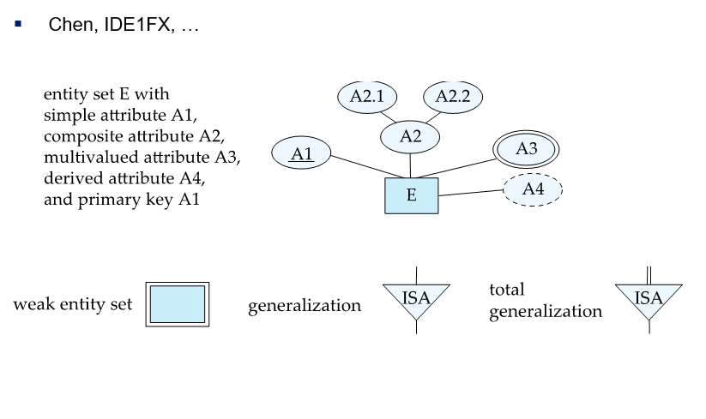
Alternative ER Notations

Slide 57
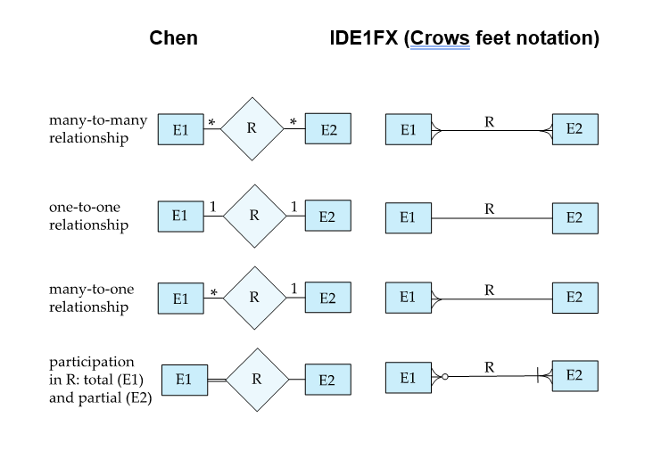
Alternative ER Notations

